Slide 1
AUTOMATED CHEQUE CLEARANCE PROCESSING
TEAM NAME : TECHDELIGHTS
TEAM MEMBERS:
JAAYASHREE M
DHANUSHYA K
HAMSAVALLI D
JAIKRITHIKA R

Slide 2
PROBLEM STATEMENT
For any bank, Cheque clearing is a very important and highly resource intensive process. On any normal day, a leading bank can receive anywhere between 3-5 lakhs of cheques for clearance. Being an intricate process, it involves multiple levels of screening and vigilance to ensure regulatory guidelines are met. For all these reasons, major parts of this process are manual in nature till date.
Automated Cheque Processing (ACP) that allows for faster cheque clearing. Paper cheques used to be processed manually, a process that took up to seven days to clear. With ACP, deposited cheques are cleared by the end of the next day if deposited by 2:00p.m.

Slide 3
INTRODUCTION
Cheque clearing is the process of moving cash (or its equivalent) from the bank on which a cheque is drawn to the bank in which it was deposited, usually accompanied by the movement of the cheque to the paying bank, either in the traditional physical paper form or digitally under a cheque truncation system.
This process is called the clearing cycle and normally results in a credit to the account at the bank of deposit, and an equivalent debit to the account at the bank on which it was drawn, with a corresponding adjustment of accounts of the banks themselves.

Slide 4
OBJECTIVES
The primary purpose of an AI based cheque clearance system is to reduce the processing time while also making the process less prone to errors and possible frauds due to collusion.
Automated check processing follows the same working principle as physical check clearing. The only difference is that the process is automated.
The withdrawal bank sends a digital copy of the cheque, accompanied by data on the MICR band. Afterward, the check is processed without manual handling from the deposit bank — this new approach is called check truncation.

Slide 5
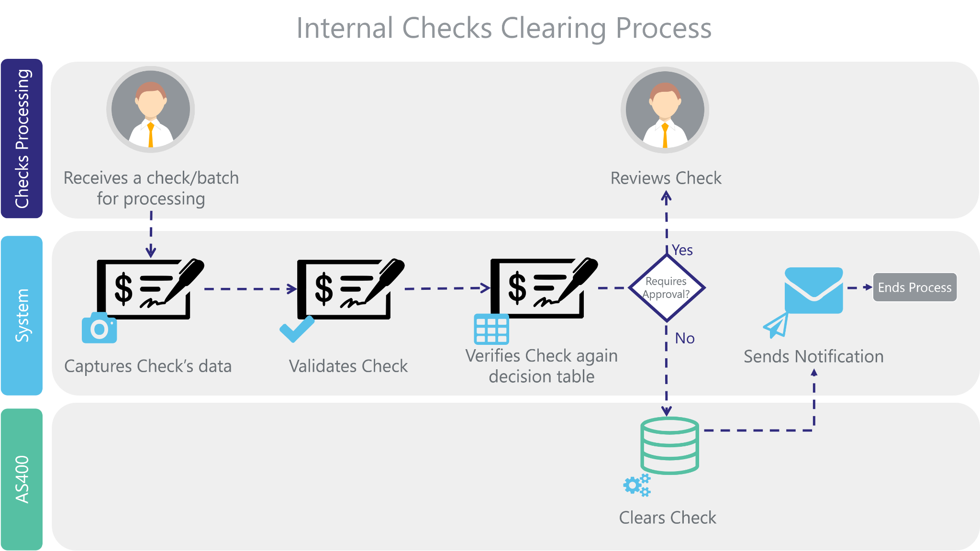

Slide 6
TECHNOLOGY USED
Implementing Optical Character Recognition (OCR) using pytesseract
Web interface using Flask
ICR Techniques
Sqlite for database
Image Processing

Slide 7
PROPOSED SOLUTION
This Web App basically consists of the following : -
1. Registration
Bearer of any bank in order to avail the online services has to
register once, which will enable him to set a unique username and password that can be used later anytime. If the details matches with the bank database at the time of
registration than a welcome message is displayed else a “Account Not Found” is displayed.

Slide 8
2. Details Page
Whenever Bearer wants to deposit a cheque for clearance he has to Login with his username and password, add details of cheque and upload a soft copy of cheque that will be used for further processing.
3. Verification
After this the scanned copy of cheque is sent to payee bank where It is checked and if the cheque gets cleared the amount is credited In bearer’s account and it is debited from payee’s account.
4. Confirmation messages
At last the confirmation messages which holds the status of the cheque clearance along with the updated balance is sent to both the parties.

